Slide 1
What do leaders do? CORES-AD 66
Pablo Hernandez-Lagos
January 28, 2016

Slide 2
Introduction: Syllabus
Instructor: Pablo Hernandez
Office: A5-1137,
Office hours: Tuesday 12pm
Email: pablo.hernandez@nyu.edu
Lectures: TuTh 10:40AM - 11:55AM. Room A5-001.

Slide 3
Introduction:
Grades
Class participation (Thursdays): 10%
Weekly one-page reports (30%) and presentations (10%, some Tuesdays): 40%
One-page reports: Almost weekly, assigned on Tuesday, due next Tuesday.
Structure of the one-page reports
First paragraph: Why do we care about what it is written in the report?
Second paragraph: Brief description of the situation that is supposed to be relevant using facts and data
Third paragraph: Why this situation involves leadership
Fourth paragraph: what do we learn from reading this report.
Structure of presentations: on Tuesdays, present the report in 5 minutes or less. Convince others those five minutes are well spent.
Midterm draft: 20% (due on April 5)
Structure of midterm draft: 4 pages
Why do we care about what it is written in the report?
Brief description of the situation that is supposed to be relevant using facts and data
Why this situation involves leadership
what do we learn from reading this report.
Final paper: 30% (due on May 10)
A revision of the midterm draft

Slide 4
What do leaders do?

Slide 5
Current managerial approach to leadership

Slide 6
Things leaders do (Llopis, 2015)
Get knowledge from others (make them think, ask questions, allocate talent)
Instinct decision making
Manage and convey expectations (measure, feedback)
Be accountable
Initiative and example (No procrastination, energy)

Slide 7
We will not spend much time on these type of recipes

Slide 8
What do leaders do?
+100,000 of books, articles, blogs, videos, movies, etc.
None of them provides the leading theory as to what leaders do.
Why?

Slide 9
(…)

Slide 10
First leader: Gilgamesh

Slide 11
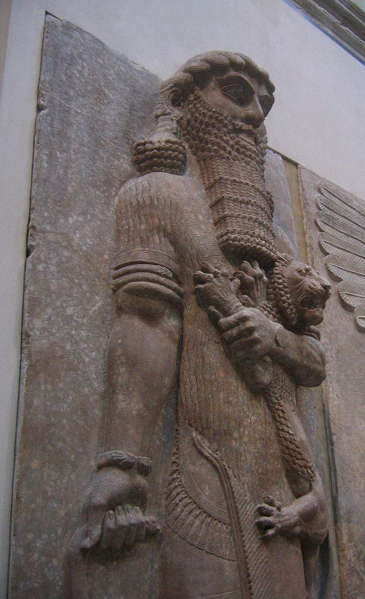
First leader: Gilgamesh

Slide 12
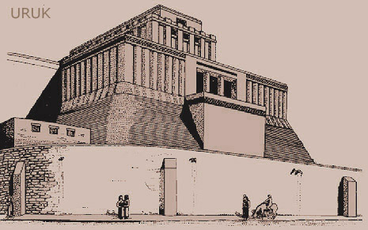
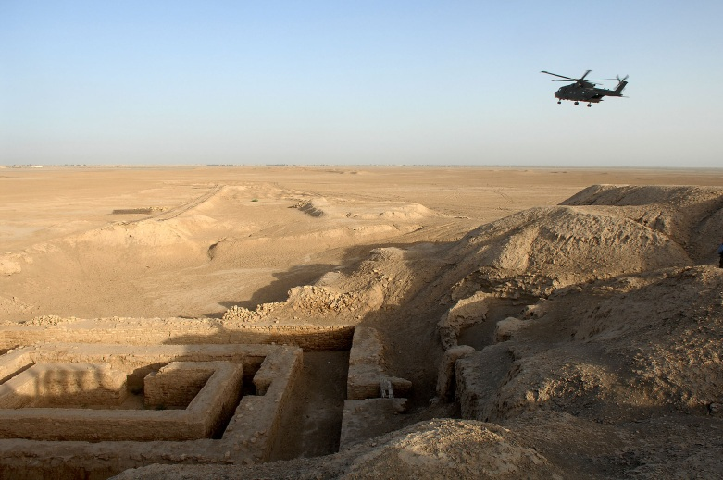
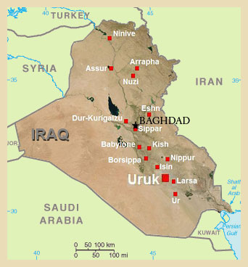
First leader: Gilgamesh

Slide 13
First leader: Gilgamesh

Slide 14
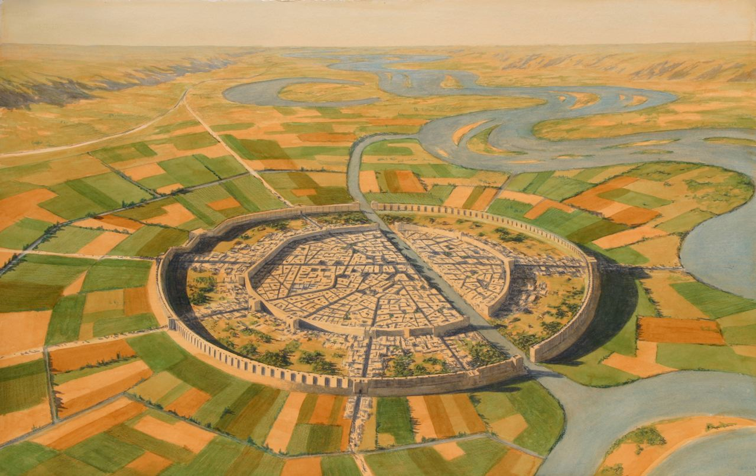
First leader: Gilgamesh

Slide 15
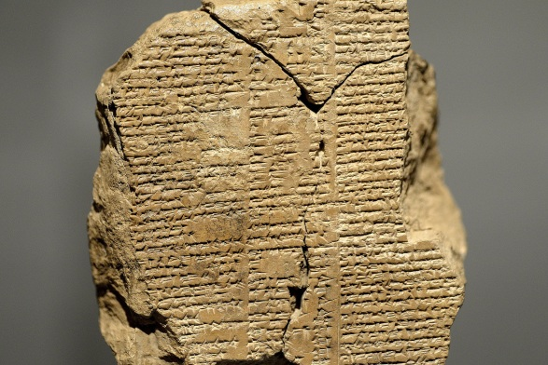
First leader: Gilgamesh
No coincidence the story is in stone
It was meant to persist
It was meant for people to believe there are “superior” humans
The hero is the first leader we know of.

